Slide 1

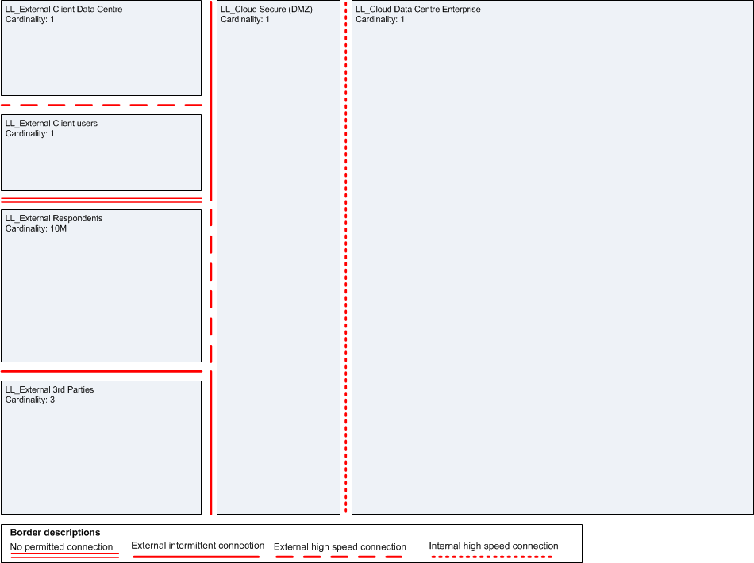
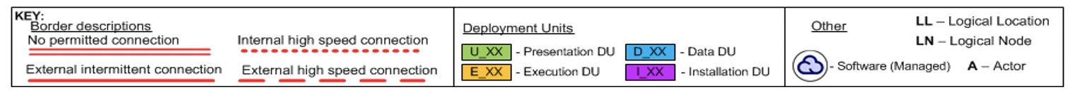
U_01
E_01
D_01
I_01
LN_Data Delivery
LN_help desk
LN_Gateway
LN_Form Handling
LN_Information
Management
LN_Device_Repulicatoin Service
LN_Security Service

